Slide 1

Introduction to MS Word 2010

Slide 2
What is Microsoft Word?
Microsoft Word 2010 is a word-processing program, designed to help you create documents such as reports, resumes, letters, memos, and newsletters. It enables you to perform basic tasks such as creating , saving, editing, formatting, and printing documents, as well as getting help.

Slide 3
How to Open MS Word 2010
There are multiple ways to start Word. You can start Word 2010 from the Start menu (in Windows 7) or by opening an existing Word file.
To start Word 2010 from the Start menu:
  Click the Start button, click All Programs ,
  click Microsoft Office , click Microsoft Word 2010.
  The program window opens with a new blank document.

Slide 4
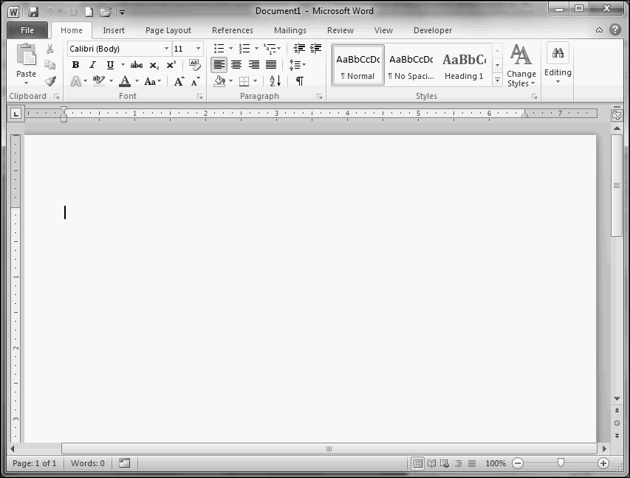
Microsoft Word Window

Slide 5
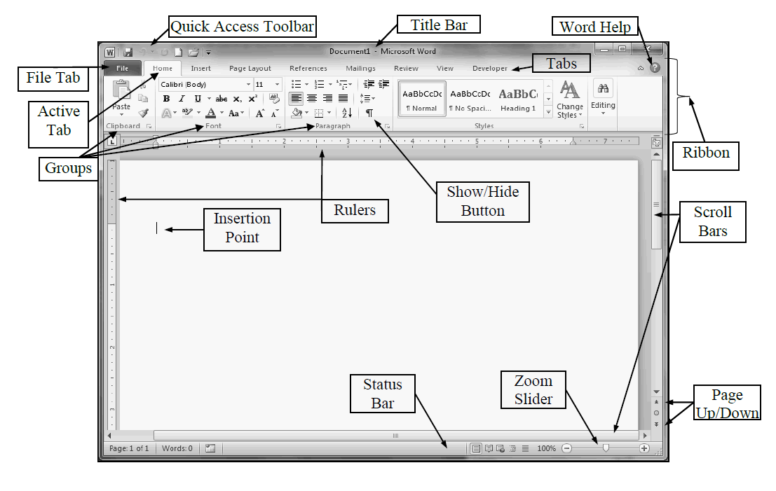
Microsoft Word Window Labels

Slide 6
Window Labels Defined
File Tab -The File Tab opens the Backstage view of Office. Backstage view is
Quick Access toolbar -Verify that a checkmark is displayed by the New, Open, Save, Undo, and Redo commands. Click any of these items that do not display a checkmark.
Title Bar - Appears at the top of the program window and displays the name of the document and the program. The buttons on the right side of the Title bar are used to minimize, maximize, restore, and close the program window.

Slide 7
Window Labels Defined cont’d
Ribbon - designed to help you quickly find the commands that you need to complete a task. It consists of a set of task -specific tabs .The main tabs are visible at all times. Other tabs, known as contextual tabs, appear only when you create or select certain types of objects (e.g., images, tables, charts).
Scroll Bar – Horizontal (bottom of window) and Vertical (right side of window) Scroll Bars may be used to scroll through the document.
Zoom Slider - click the buttons to decrease or increase the on-screen size of your document.

Slide 8
Typing Text
Firstly find where you want to type in the document (Insertion Point).
Place the pointer in area by clicking.
Start typing
In addition to typing directly into the document, you can insert text by selecting the text, copying and pasting or dragging and dropping text from one document to another or one location to another.

Slide 9
Deleting Text
You can use the Backspace or Delete key to delete text one character at a time.
-The Backspace key removes the character to the left of the cursor;
- the Delete key removes the character to the right of the cursor.
You can also select and delete a word, sentence, paragraph, or block of text.
To delete text:
  -Highlight the text that you want to delete, and then press the Delete key.

Slide 10
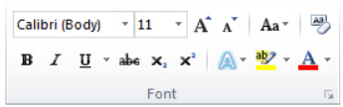
Formatting Text
Mini Toolbar contains frequently used formatting commands and appears in a semi- transparent mode whenever text is selected. Moving the mouse pointer over the toolbar activates it and makes the options available for use.
Character formatting enhances the appearance of text and includes font, font size, font style and effect, and font colour. You can use the commands in the Font group on the Home tab of the Ribbon to quickly apply character formatting

Slide 11
Formatting Text cont’d
To change the font:
  Select the text that you want to format
  On the Home tab, in the Font group, click the Font
arrow and select the desired font from the list.
Or
You can use the Mini Toolbar

Slide 12
Formatting Text cont’d
To change the font size:
Select the text that you want to format .
On the Home tab, in the Font group, click the Font Size arrow and select the desired font size from the list. If a font size you want is not listed in the Font Size list, click in the Font Size box, type the desired number, and then press the Enter key.
NOTE: You can also change the font size by clicking the Grow Font button or Shrink Font button in the Font group on the Home tab of the Ribbon

Slide 13
Creating a New Document
Click the File tab and then click New.
Under Available Templates, click Blank Document.
Click Create.

Slide 14
Saving A Document
To save a document in the format used by Word 2010 and Word 2007, do the following:
Click the File tab.
Click Save As.
In the File name box, enter a name for your document.
Click Save.

Slide 15
Printing Document
Click the File tab and then click Print.
Do the following:
Under Print, in the Copies box, enter the number of copies that you want to print.
Under Printer, make sure that the printer that you want is selected.
Under Settings, the default print settings for your printer are selected for you. If you want to change a setting, click the setting you want to change and then select the setting that you want.
When you are satisfied with the settings, click Print.

Slide 16
Exiting Microsoft Word
When you finish using Word 2010, you should exit the program to free up system resources. To exit Word 2010: (after saving your document)
1. Click the File tab, and then click Exit.
Or,
2. Click the Close button in the upper-right corner of the program window.

Slide 17
Page layout and formatting
Word offers a variety of page layout and formatting options that affect how content appears on the page. You can customize the page orientation, paper size, and page margins depending on how you want your document to appear.

Slide 18
To change page orientation:
Select the Page Layout tab.
Click the Orientation command in the Page Setup group.

Slide 19
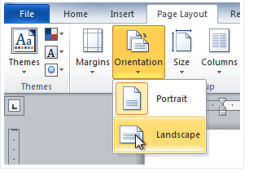

Slide 20
To change page size:
Select the Page Layout tab.
Click the Size command, and a drop-down menu will appear. The current page size is highlighted.

Slide 21
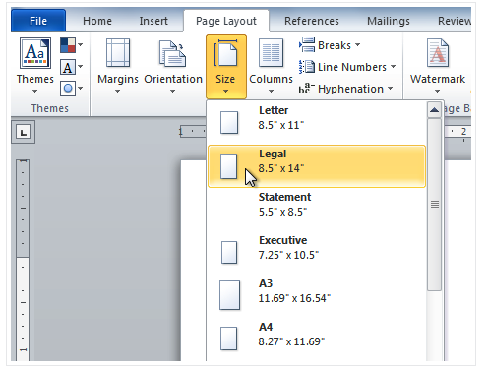

Slide 22
To format page margins:
Select the Page Layout tab.
Click the Margins command. A menu of options appears. Normal is selected by default.
Click the predefined margin size you want.

Slide 23
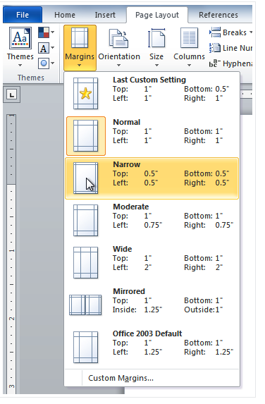

Slide 24
To use custom margins:
From the Page Layout tab, click Margins.
Select Custom Margins. This will take you to the Page Setup dialog box.
Adjust the margin sizes for each side of the page, then click OK.

Slide 25
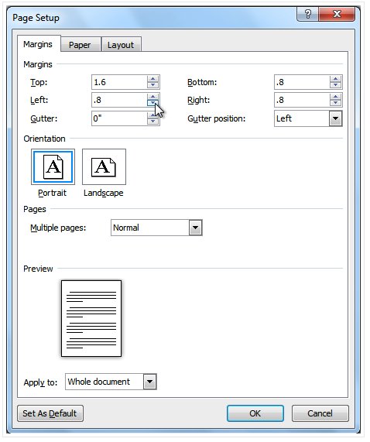

Slide 26
Line and Paragraph Spacing
An important part of creating effective documents lies in the document design. When designing your document and making formatting decisions, you will need to know how to modify the spacing. In this lesson, you will learn how to modify the line andparagraph spacing in various ways

Slide 27
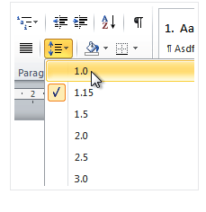

Slide 28
Line spacing
Adjusting the line spacing will affect how easily your document can be read. You can increase spacing to improve readability, or reduce it to fit more text on the page.

Slide 29
To format line spacing
Select the text you want to format.
Click the Line and Paragraph Spacing command in the Paragraph group on the Home tab.
Select the desired spacing option from the drop-down menu

Slide 30
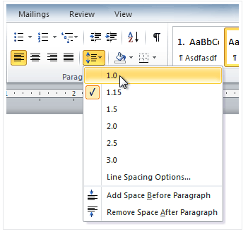

Slide 31
Inserting Clip Art and Pictures
Images are a great way to liven up a document, and Word offers a few methods to insert them. There are built-in clip art images for just about every topic, so you may be able to find a perfect clip art image for your document. If you have a more specific image in mind, you can insert a picture from a file

Slide 32
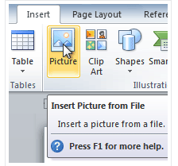

Slide 33
Inserting clip art and pictures
Adding clip art and pictures to your document can be a great way to illustrate important information or add decorative accents to existing text. You can insert images from your computer or search Microsoft's extensive selection of clip art to find the image you need. Once an image has been inserted, you can format text to wraparound the image

Slide 34
To insert a picture from a file
Place your insertion point where you want the image to appear.
Select the Insert tab.
Click the Picture command in the Illustrations group. The Insert Picture dialog box appears.

Slide 35
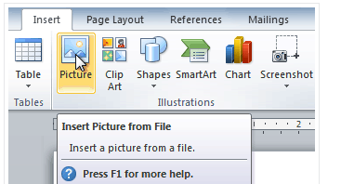

Slide 36
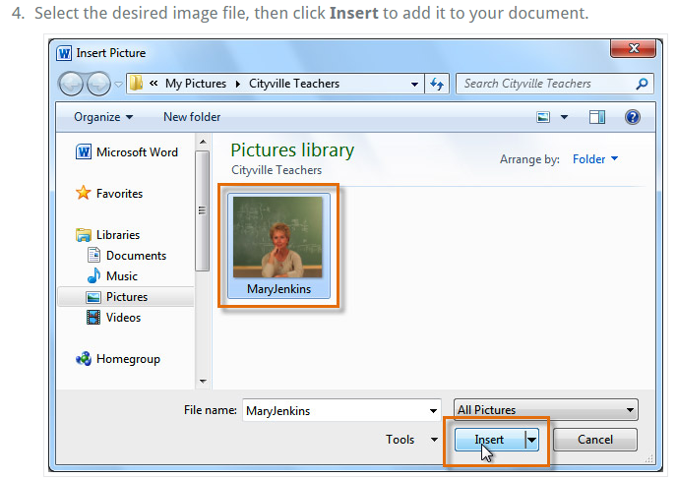

Slide 37
Working with Headers and Footers
You can make your document look professional and polished by utilizing the header and footer sections. The header is a section of the document that appears in the top margin, while the footer is a section of the document that appears in the bottom margin. Headers and footers generally contain information such as the page number, date, and document name.

Slide 38
To insert a header or footer:
Select the Insert tab.
Click either the Header or Footer command. A drop-down menu will appear.
From the drop-down menu, select Blank to insert a blank header or footer, or choose one of the built-in options.

Slide 39
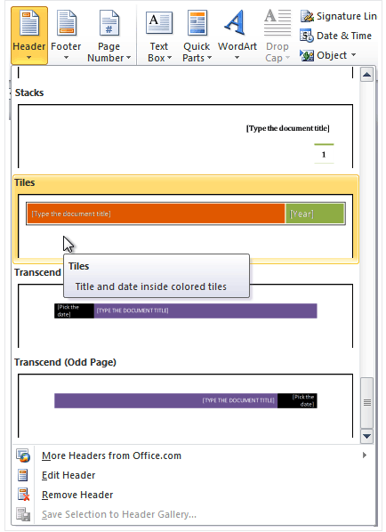

Slide 40
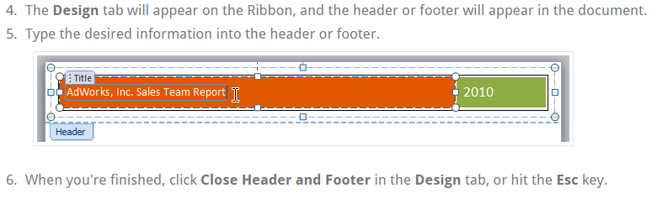

Slide 41
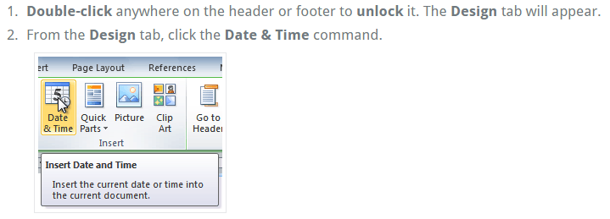
To insert the date or time into a header or footer:

Slide 42
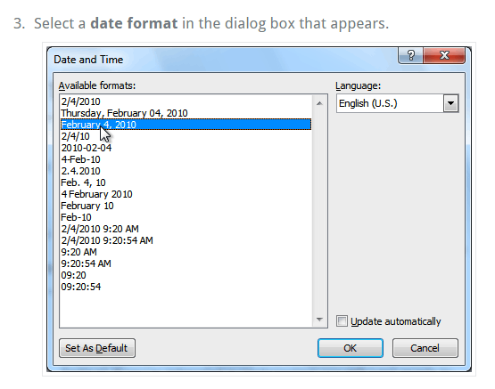

Slide 43
Place a check mark in the Update Automatically box if you would like it to always reflect the current date. Otherwise, it will not change when the document is opened at a later date.
Click OK. The date and time now appears in the document.

Slide 44
Adding page numbers
Word can automatically label each page with a page number and place it in a header, footer, or side margin. You can add page numbers to an existing header or footer, or you can insert page numbers into a new header or footer

Slide 45
To add page numbers to an existing header or footer:
Select the header or footer. The Design tab will appear.
Place the insertion point where you want the page number to be. You can place it anywhere except inside acontent control field

Slide 46
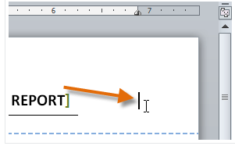

Slide 47
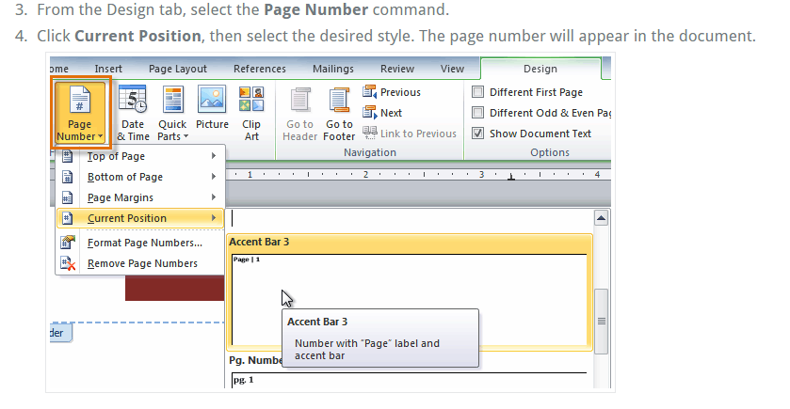

Slide 48
To hide the page number on the first page
In some documents, you may not want the first page to show the page number. You can hide the first page number without affecting the rest of the pages.
Select the header or footer that contains the page number.
From the Design tab, place a check mark next to Different First Page. The header and footer will disappear from the first page. If you want, you can type something new in the header or footer, and it will only affect the first page.

Slide 49
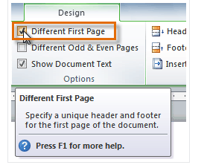

Slide 50
To format page numbers:
Select the header or footer that contains the page number.
From the Design tab, select the Page Number command.
Click Format Page Numbers

Slide 51
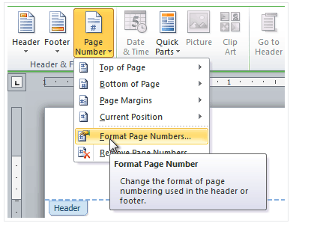

Slide 52
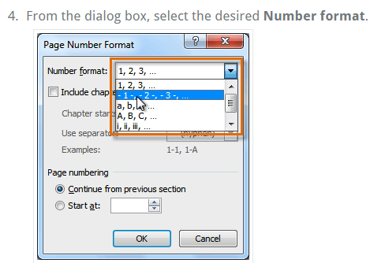

Slide 53
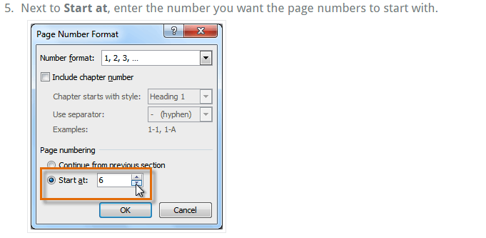

Slide 54
Working with Tables
A table is a grid of cells arranged in rows and columns. Tables can be customized and are useful for various tasks such as presenting text information and numerical data.
In this lesson, you will learn how to convert text to a table, apply table styles, format tables, and create blank tables.

Slide 55
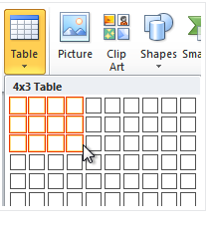

Slide 56
Inserting and modifying tables
In Word, tables are useful for organizing and presenting data. You can create a blank table, convert text to a table, and apply a variety of styles and formats to existing tables.

Slide 57
To insert a blank table:
Place your insertion point in the document where you want the table to appear.
Select the Insert tab.
Click the Table command.
Hover your mouse over the diagram squares to select the number of columns and rows in the table.

Slide 58
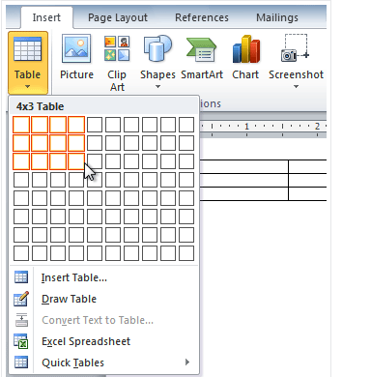

Slide 59
Click your mouse, and the table appears in the document.
You can now place the insertion point anywhere in the table to add text.

Slide 60
To convert existing text to a table:
Select the text you want to convert.
Select the Insert tab.
Click the Table command.
Select Convert Text to Table from the menu. A dialog box will appear

Slide 61
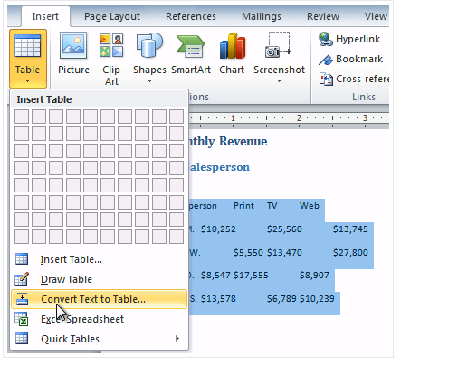

Slide 62
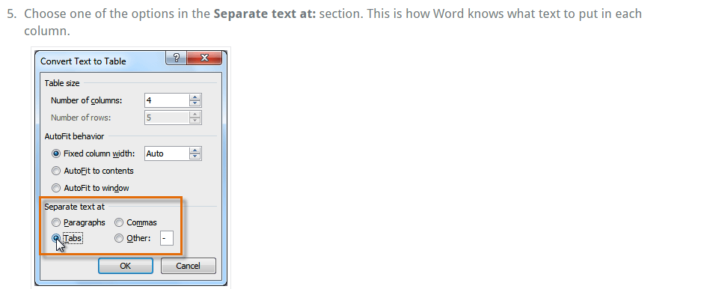

Slide 63
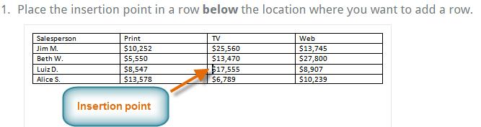
To add a row above an existing row

Slide 64


Slide 65
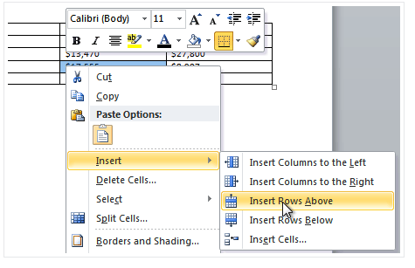

Slide 66
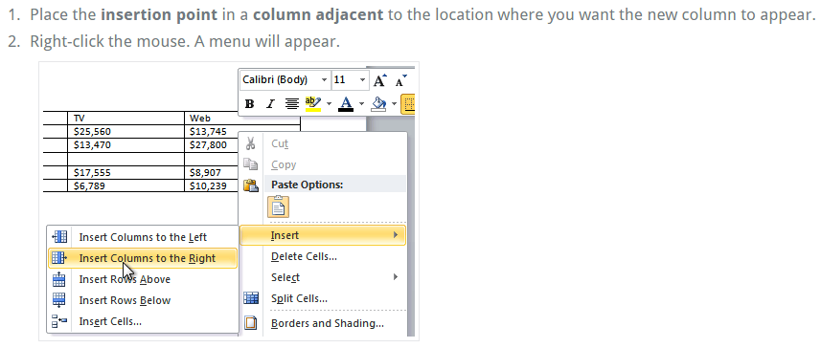
To add a column:

Slide 67
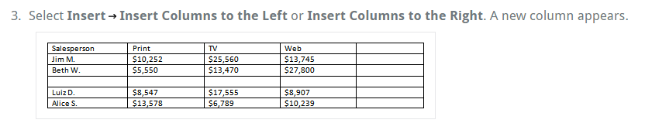

Slide 68
To delete a row or column:
Select the row or column.
Right-click your mouse. A menu will appear.
Select Delete Cells.

Slide 69
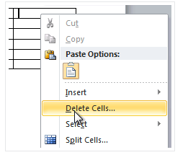

Slide 70
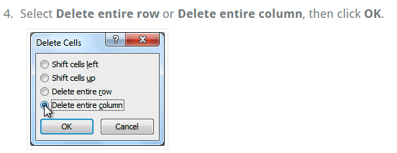

Slide 71
To apply a table style:
Click anywhere on the table. The Design tab will appear on the Ribbon.
Select the Design tab and locate the Table Styles.
Click the More drop-down arrow to see all of the table styles.

Slide 72
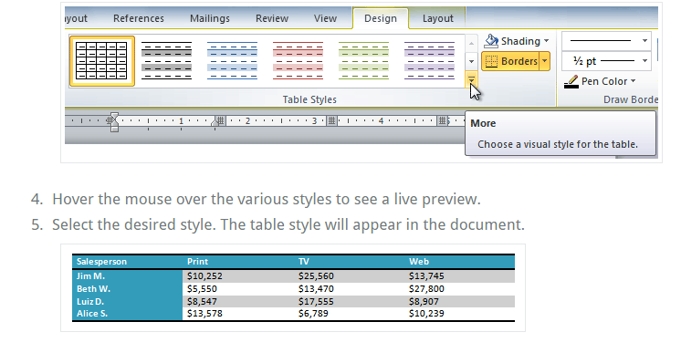

Slide 73
To change table style options
Click anywhere on the table. The Design tab will appear.
From the Design tab, check or uncheck the desired options in the Table Style Options group.

Slide 74
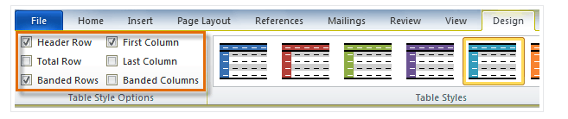

Slide 75
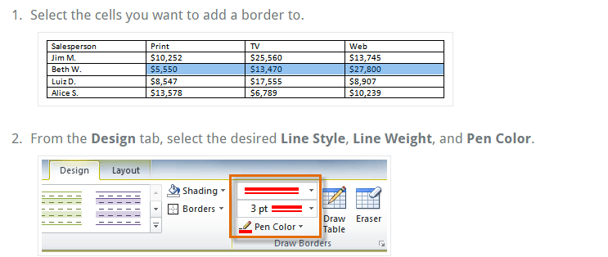
To add borders to a table:

Slide 76
